Slide 1

Rehabilitation Counseling 697
Special Topics in Innovative Best Practices in Employment for People with Intellectual Disabilities
Best Practices in Assessment:
Moving Beyond Traditional Assessments
David Hoff, M.S.W.
Institute for Community Inclusion
david.hoff@umb.edu - 617-480-9230

Slide 2

Discussion:
What is the purpose of assessment?

Slide 3
Assessment Values
Strength-based
Presume employability
Comprehensive:
full range of employment related variables
Reflective of self-direction and informed choice
Individualized

Slide 4

Avoid the employment readiness myth
“Employers are expecting perfect employees.”

Slide 5
Have you ever worked with anyone who…
Couldn’t get along with others?
Acted inappropriately?
Had behavioral outbursts?
Was chronically late?
Complained about everything?
Didn’t communicate well?
Didn't work very fast?
Got distracted easily?

Slide 6
Have you ever worked with anyone who…
Didn’t take directions well…or at all?
Acted impulsively without thinking?
Had a messy office?
Wasn’t organized?
Wasn’t always professional?
Was rude?
Couldn’t take criticism?
Was lazy?
Wasn’t very good at their job – but managed to still keep it?

Slide 7
Assessment Techniques
Aptitude assessments
Interest inventories
Simulated work
Person-centered planning
Situational assessments (community based)
Others

Slide 8

What is being assessed?
Job interests
Work-related skills, talents
Work environment preferences
Social skills
Self-care skills
Work ethic and endurance
Accommodation and support needs
Others
Examine:
Strengths
Areas for improvement

Slide 9
Facilitating Integration Into The Workforce
Person
Work Environment
Job
Marston,D. (2015). Behavioral Assessment and Vocational Training Programs for Individuals With Intellectual Disability

Slide 10

Remember:
Assessment is contextual in terms of the environment and tasks being performed

Slide 11
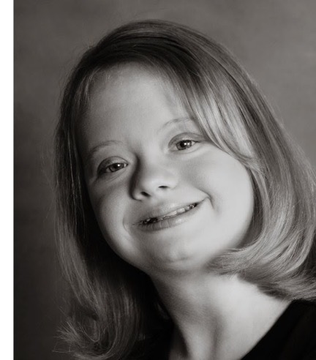
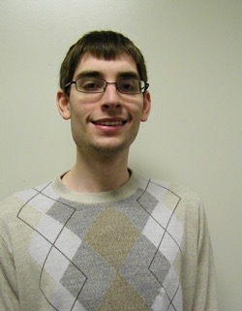
Impact of Intellectual Disability on Individual
Social skills
Communication skills
Increased time needed for cognitive process and learning
Low literacy (reading, writing, math)
Challenges with abstract concepts
Challenges w/transferring learning
This Photo by Unknown Author is licensed under CC BY-NC-ND

Slide 12
Social & Societal Impact of Intellectual Disabilities
Low & narrow expectations
  Personally & externally
Limited experience
Deference to others
Individual acquiesces to authority –
“aim to please”
Lack of skills in choice making &
self-determination
Stereotypes regarding societal role and abilities
Others

Slide 13
Discussion:
How do these factors impact assessment?

Slide 14
The Challenge of
Traditional Assessments
Narrow focus on work skills
Require abstract thinking, transferring of experience
Over-reliance on professional judgement
Don’t account for wide range of variables in typical work environments
Others

Slide 15

Person-Centered Planning as Basis
Gather information from
cross-section of individuals involved in person’s life about person’s experiences, interests, dreams, preference
Conductive collective brainstorming
Identify options
Tap into personal networks
Empower the individual

Slide 16
Community-Based Assessments
Performance of tasks for assessment within real work environment
Allows for evaluation of full range of employment-related factors/variables
Should be driven by individual interests/preferences
Use a variety of environments
Workforce Innovation and Opportunity Act (WIOA)
reinforces use of community-based settings:
assessment should rely “on information obtained from experiences in integrated employment settings in the community and in other integrated community settings”

Slide 17
Challenges of Community-Based Assessments
Requires significant time and resources to arrange and support
Need cooperation of local businesses
Liability issues
Compliance with wage and hour laws
Limits of logistics/dynamics of worksite
  Particularly with interventions
Avoiding stigma

Slide 18
Preparing for Community-Based Assessment
Identify with individual potential areas of interest
Ensure individual is comfortable with a community- based assessment
Identify settings that match interest
Identify with business tasks to be performed
Review with business details of how assessment will take place (day, hours, staffing, informing other staff, etc.)
  Possible written agreement
Review with individual details of assessment

Slide 19

Conducting Community-Based Assessment
Assess on as wide a variety of tasks as possible
Encourage interactions with others in the workplace
Minimize the intrusion in the workplace as much as possible
Use a standardized instrument to collect data on the full range of variables
  Possibly conduct a task analysis
Possible use of pictures/video

Slide 20
Examples of Areas to Assess
Interest in tasks
Focus/attention
Ability to master tasks
Ability to self-initiate
Ability to handle complex tasks
Ability to multi-task
Stamina & endurance
Physical requirements
Level of worker autonomy
Communication
Comfort with physical environment
Fit with social environment
Appropriate social interactions
Pace/production rate
Reading requirements
Math requirements
Safety
Accommodation & support needs

Slide 21
Examples of Information Collection

Slide 22





Individual Reflection
1:1 staff
Group and Peer-to-peer
Writing & journaling
Use of pictures and video

Slide 23

Areas for Reflection
Likes and dislikes about experience
  Tasks, environment, co-workers, etc.
Successes & challenges
Areas to work on improving & build skills in
Supports and assistance needed
Possible accommodations & assistive technology
Handling disclosure of disability
How lessons learned can be applied in choosing future experiences, and building blocks for employment preferences
Others

Slide 24

Striking the Right Balance
Individual who is perceived to have limited abilities is often given unchallenging tasks that essentially convey a disbelief in individual’s ability to perform.
Inconsequential or simple tasks can reinforce lower career and academic expectations of parents, school counselors, staff.
Tasks must not be so difficult that mastery is unlikely or so easy that message of lowered ability expectations is conveyed.
Career Expectations and Aspirations of Youth With and Without Disabilities, Fisher & Harnisch, 1992

Slide 25

Assessment within a cultural context
Issues and considerations

Slide 26


Questions, Discussion, Wrap-Up

Slide 27

“Presume competence. And what we mean by presuming competence is when you meet a person with a disability you assume they are capable.
Don’t assume that someone can or can’t do things but make sure they tell you what they need for accommodations and give them the chance to be in the driver’s seat.”
Max Barrows
Green Mountain Self-Advocates

